Slide 1
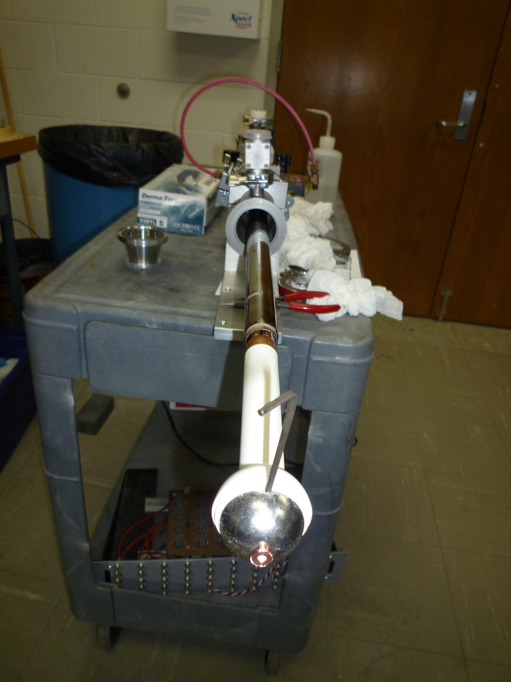
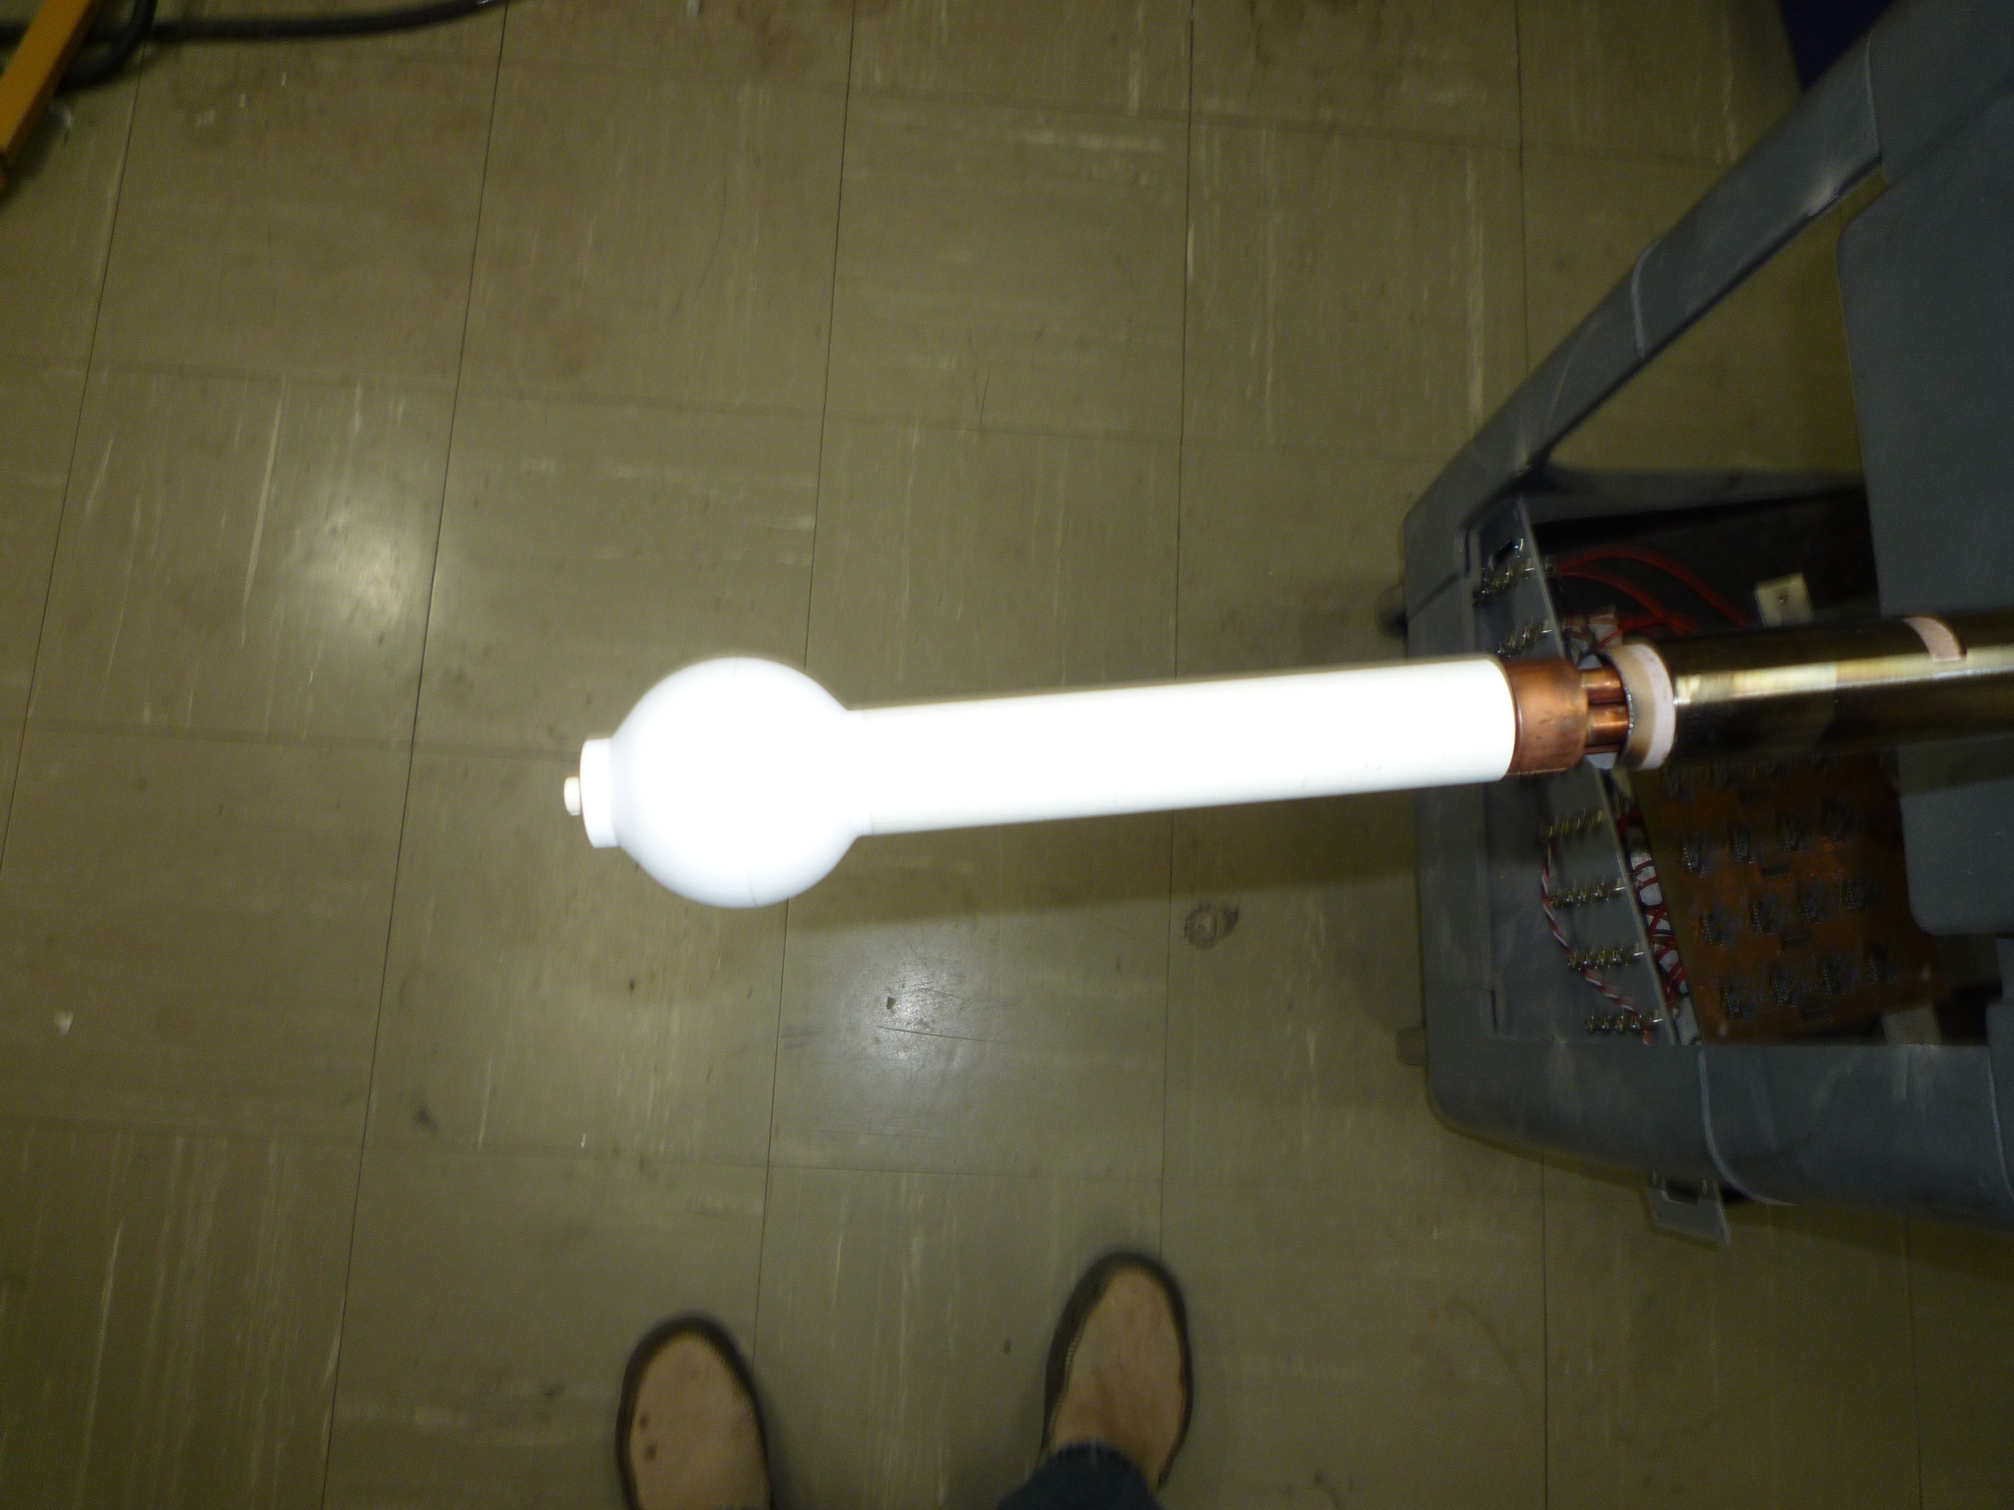
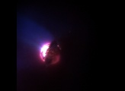
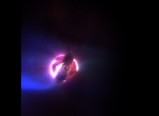
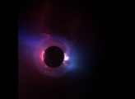
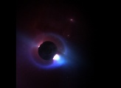
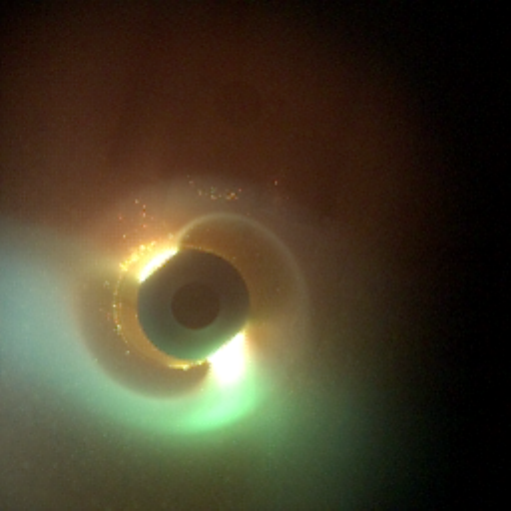
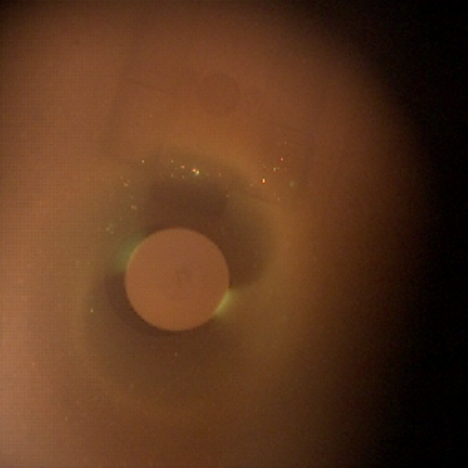
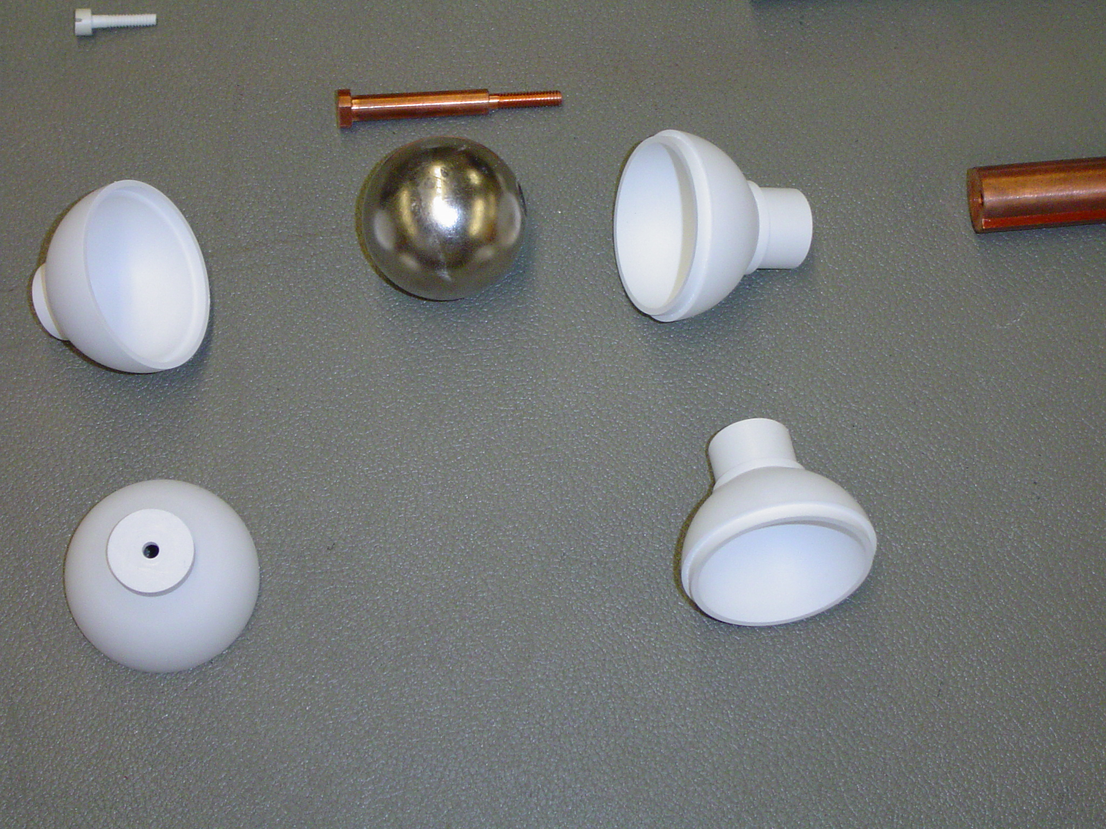
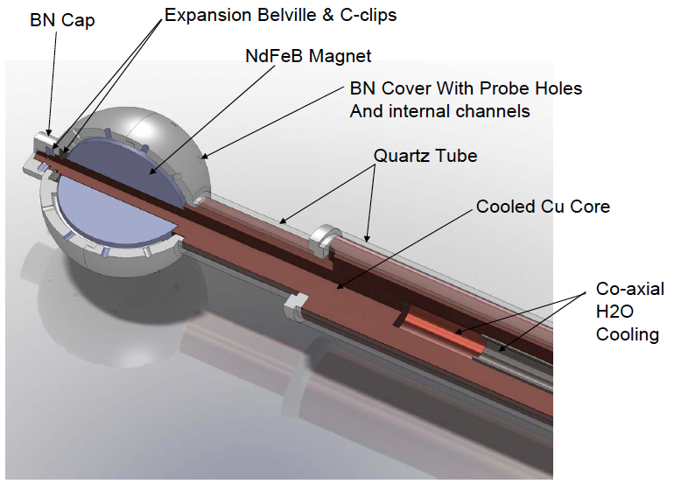
Terrella experiments in MST*
A. H. Seltzman, A. F. Almagri, C. B. Forest, J. S. Sarff, J. C. Triana, J. Wallace.
UW-Madison, and CMSO
Introduction
Bias electrodes spin up the plasma to study mockup of solar winds.
Edge toroidal flow can increase instantaneously to 30-40 km/s.
The Terrella dipole can be aligned parallel and antiparallel to B_{o}.
Plasma Spin up
Terrella Probe
Normal Helicity
Reversed Helicity
Parallel to Bo, Jan-10-2012, #3
Parallel to Bo, Jan-10-2012, #13
A Terrella-like probe inserted into MST plasma at
the reversal surface where the mean magnetic field
is poloidal to study solar wind and reconnection.
A rare earth permanent magnet NdFeB
Covered with BN shield
Temperature < 80 c
B (poles) 0.88 T
B (equator) 0.44 T
Diameter 1.5 inches
New Instrumented Terrella Probe
Anti-parallel to Bo, 1-10-2012, # 1
Anti-parallel to Bo, Jan-10-2012, #12
Toroidal Direction
The probe is viewed diagonally across with Vision Research Phantom v710 camera.
Capable of speed 1.4 megaframes/sec.
Film speed is 80k frames/sec
Exposer time is12 microsec.
Poloidal Direction
Anti-parallel to Bo, 12-31-2011, # 80

